Slide 1
Unit 4
Packages and JAVA Library: Introduction, Defining Package, Importing Packages and Classes into Programs, Path and Class Path, Access Control, Packages in JAVA SE, java.lang Package and its Classes, Class Object, class Math, Wrapper Classes, Auto-boxing and Auto-unboxing.
Exception Handling: Introduction, Hierarchy of Standard Exception Classes, Keywords throws and throw, try, catch, and finally Blocks, Multiple Catch Clauses, Class Throwable, Unchecked Exceptions, Checked Exceptions, custom exceptions.
Java I/O and File: Java I/O API, standard I/O streams, types, Byte streams, Character streams, Scanner class, Files in Java: File, FileInputStream and FileOutputStream Classes

Slide 2
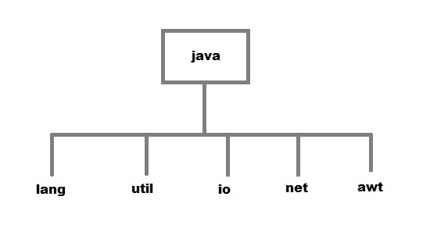
Packages and JAVA Library
JAVA follows OOP
Number of built in classes and interfaces are there
For proper management of classes and interfaces, the related classes and interfaces are grouped into packages and sub-packages.
The default package is java.
A large number of the packages and sub-packages are contained in the package java.

Slide 3
Packages as Name Space
A package provides a name space in which the classes and interfaces have unique names.
Same names may be used in different packages without ambiguity.
Similarly, the class name and interface also provide name spaces in which the names of variables and methods are unique.

Slide 4
Built-in Packages
Package Name | Description
java.lang | Contains language support classes ( for e.g classes which defines primitive data types, math operations, etc.) . This package is automatically imported.
java.io | Contains classes for supporting input / output operations.
java.util | Contains utility classes which implement data structures like List, Hash Table, Dictionary, etc and support for Date / Time operations. This package is also called as Collections.
java.applet | Contains classes for creating Applets.
java.awt | Contains classes for implementing the components of graphical user interface ( like buttons, menus, etc. ).
java.net | Contains classes for supporting networking operations.
javax.swing | This package helps to develop GUI like java.awt. The ‘x’ in javax represents that it is an extended package which means it is a package developed from another package by adding new features to it. In fact, javax.swing is an extended package of java.awt.
java.sql | This package helps to connect to databases like Oracle/Sybase/Microsoft Access to perform different operations.

Slide 5
User defined packages
One of the important features of the Java is that it allows a programmer to build his/her own packages and classes.
A programmer can save his/her own packages and classes in a directory, and from there, it can be imported to the application program by using import keyword.
To create a user defined package, in program the first instruction must be
  package packagename;

Slide 6
Defining a Package
A package comprises a group of similar type of classes, interfaces, and sub-packages.
It is defined with the keyword package followed by the name of the package and a semicolon
Package statement is the first statement in a program, No other code line can be placed above it expect the comments.

Slide 7
Defining a Package
Rules:
  All the members of a package must have unique names, otherwise compile-type error will occur.
  Packages also provide an access control mechanism.
  A package that is not a sub-package of another package can have a simple name. Examples are java, javax, and javafx
  Qualified name:
    If a package contained another sub-packages we use qualified name.
    Qualified name consists of names of pakages/sub-package separated by .(dot)

Slide 8
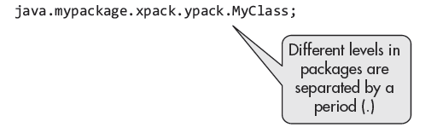
Defining a Package
package java.mypackage.xpack.ypack;// qualifi ed name for ypack
package java.mypackage;// qualified name for mypackage
package java.mypackage.xpack; // qualified name for xpack
package java.mypackage.xpack.ypack;// qualified name for ypack

Slide 9
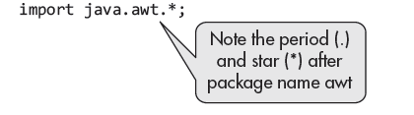
Importing Packages and Classes into Programs
Most of the Java programs need to refer to one or more packages and classes in the source code.
If a program needs several classes of a package, it is better to import the whole package
For a particular class may be included in a program by importing it through its fully qualified name

Slide 10
How to access package from another package?
There are three ways to access the package
  import package.*;
  import package.classname;
  fully qualified name.
Method | Syntax | When to use
Fully qualified name | pack.Addition a = new pack.Addition(10,15); | Using a class once, or avoiding name clashes
Import a single class | import pack.Addition; | Only a few classes needed
Import all classes | import pack.*; | Many classes from the same package

Slide 11
PATH and CLASSPATH
PATH - is an environment variable is used to tell the location of built-in directories such as javac, java, jar, javadoc, appletviewer ...
Path tells the system where to locate the JDK files that contain these commands.
CLASSPATH –
    The class path environment variable is used to specify the location of the user defined classes and packages.

Slide 12
TO WORK WITH USER DEFINED PACKAGES – SETTING CLASSPATH
First, by default, the Java run-time system uses the current working directory as its starting point.
If your package is in a subdirectory of the current directory, it will be found.
Second, you can specify a directory path or paths by setting the CLASSPATH environmental variable.
  Ex: UseofPack.java is in E Drive and Package is in F drive

Slide 13
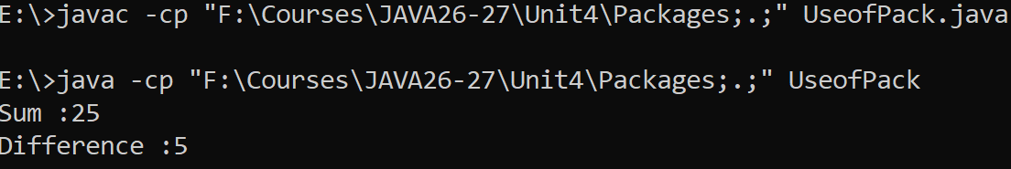
Third, you can use the –cp(classpath) option with java and javac to specify the path to your classes.

Slide 14
jar file(Java Archive)
JAR (JAVA Archive) file is a file that contains compressed venison of class files, audio files, image files and directories.
To create JAR file use jar command
  jar cf outputfile_name.jar input_files
    jar cf file_name
    jar cvf file_name – create verbose
    jar tf file_name - table view of file contents
    jar xf file_name - extract file

Slide 15
How to use JAR files
Go to the environment variables.
Go to user environment variables and click on new button
Set the classpath
  Variable name CLASSPATH
  Variable value
    F:\Courses\JAVA26-27\Unit4\Packages\PVPSIT.jar;.;
Click OK and Close

Slide 16
Access Control
The packages are containers of sub-packages, classes, and interfaces.
The encapsulation of related classes in packages provides two benefits:
  (i) Name space
  (ii) Access protection - control which classes and members can be accessed from other packages.
  Access is controlled using public, protected, default, and private.
college.student
└── Student
company.R_D
└── Student

Slide 17
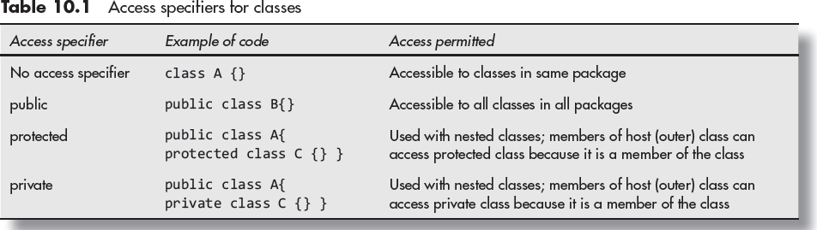
Access specifiers for classes
Generally, protected and private are used only in nested classes.

Slide 18
CLASS
┌───────┴────────┐
│ │
TOP-LEVEL CLASS NESTED CLASS
│ │
↓ ↓
public public
default protected
private
default
A top-level class can be only public or default, whereas a nested class can use all four access specifiers: public, protected, private, and default.

Slide 19
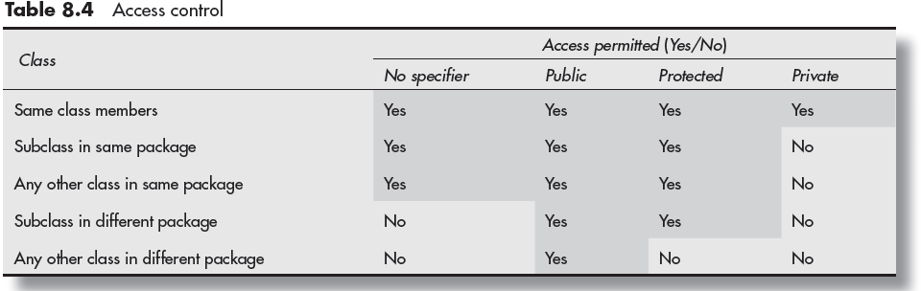
Access Control

Slide 20
Control of access to class members

Slide 21
java.lang Package and its classes
java.lang package is imported into every Java program by default.
This package contains classes and interfaces that are essential for the design of Java programming language and are as follows:
  Object class is the root of all classes
  Primitive data types
  Classes access system resources and other low level entities
  Math class – for mathematical operations
  Class Throwable – for errors and exceptions
  Thread class – to implement threads
  To work with strings such as String, StringBuffer

Slide 22
Boolean − The Boolean class wraps a value of the primitive type boolean in an object.
Byte − The Byte class class wraps a value of primitive type byte in an object.
Character − The Character class offers a number of useful class (i.e., static) methods for manipulating characters.
Class − The Class class instance represent classes and interfaces in a running Java application. It has no public constructor.
String − Strings, which are widely used in Java programming, are a sequence of characters. In Java programming language, strings are treated as objects. The Java platform provides the String class to create and manipulate strings.
StringBuffer − The StringBuffer class is mutable sequence of characters. StringBuffer can be used to modify the content of a String with ease. It provides many utility functions to manipulate a string.
StringBuilder − The StringBuilder class is mutable sequence of characters. This provides an API compatible with StringBuffer, but with no guarantee of synchronization.
System − The System class contains several useful class fields and methods. It cannot be instantiated.

Slide 24
Interfaces defined in java.lang package
1. Appendable
  This interface is designed for objects that can have characters or sequences of characters appended to them.
  Classes that implement this interface include StringBuilder and BufferedWriter.
2. AutoCloseable
  This interface provides a mechanism for objects that need to release resources when they are no longer in use. It has a single method: close().
  Commonly used with the try-with-resources statement. Many classes like FileInputStream and Scanner implement this interface.
3. CharSequence
  Represents a readable sequence of characters. It is a base interface for several classes like String, StringBuilder, and StringBuffer.
4. Cloneable
  This interface indicates that a class can be cloned, meaning it supports the creation of an exact copy of its instances using the clone() method.
  Classes implementing this interface can override the clone() method from Object to allow for object duplication.

Slide 25
5. Comparable<T>
  This interface is used to impose a natural ordering on objects of each class that implements it. It contains the method compareTo(T o). .
6. Iterable<T>
  This interface represents a collection of objects that can be iterated over, typically using a for-each loop.
  It defines the method iterator(). Collections like List and Set implement this interface.
7. Readable
  This interface represents a source of characters that can be read into a CharBuffer. It has a single method: read(CharBuffer cb).
8. Runnable
  This interface is used for classes whose instances are intended to be executed by a thread. It has a single method: run().
  It is commonly implemented when creating threads in Java, either directly or indirectly via the Thread class.

Slide 26
Class Object
It is the super class for all classes in Java. This class has one constructor and 11 methods.

Slide 27
Class Math
The Math class is an important class in the java.lang package.
It provides methods to perform mathematical calculations.
Some common operations are:
  Trigonometric functions → sin(), cos(), tan()
  Power and exponential functions → pow(), exp()
  Rounding functions → round(), ceil(), floor()
  Other functions → sqrt(), abs(), max(), min()

Slide 28
  Math is a final class, so we cannot create a subclass of Math.
  All methods in the Math class are static.
  Therefore, we do not need to create an object of the Math class.
  But we use the class name Math to call its methods.
  For example:
  double x = Math.sqrt(25);
  System.out.println(x);

Slide 29
Method | Description | Return Type | Example
abs(x) | Returns the absolute value of x. | double, float, int, long | Math.abs(-10) → 10
sqrt(x) | Returns the square root of x. | double | Math.sqrt(25) → 5.0
pow(x, y) | Returns x raised to the power y. | double | Math.pow(2, 3) → 8.0
ceil(x) | Returns the smallest integer value greater than or equal to x. | double | Math.ceil(4.2) → 5.0
floor(x) | Returns the largest integer value less than or equal to x. | double | Math.floor(4.8) → 4.0
round(x) | Rounds the value to the nearest integer. | int, long | Math.round(4.6) → 5
max(x, y) | Returns the greater of x and y. | double, float, int, long | Math.max(10, 20) → 20
min(x, y) | Returns the smaller of x and y. | double, float, int, long | Math.min(10, 20) → 10
random() | Returns a random value from 0.0 (inclusive) to 1.0 (exclusive). | double | Math.random() → 0.735
sin(x) | Returns the sine of x, where x is in radians. | double | Math.sin(0) → 0.0
cos(x) | Returns the cosine of x, where x is in radians. | double | Math.cos(0) → 1.0
tan(x) | Returns the tangent of x, where x is in radians. | double | Math.tan(0) → 0.0

Slide 30
Wrapper Classes
In Java, everything can be viewed as an object.
However, primitive data types such as int, char, double, and boolean are not objects.
Java provides Wrapper Classes to convert primitive data types into objects.
A wrapper class wraps or encloses a primitive value inside an object.
Wrapper classes are available in the java.lang package.
Wrapper class objects are used to pass arguments to collection framework methods.

Slide 31
Primitive Type | Wrapper Class | Example
byte | Byte | Byte b = 10;
short | Short | Short s = 20;
int | Integer | Integer i = 100;
long | Long | Long l = 1000L;
float | Float | Float f = 10.5f;
double | Double | Double d = 25.5;
char | Character | Character c = 'A';
boolean | Boolean | Boolean b = true;

Slide 32
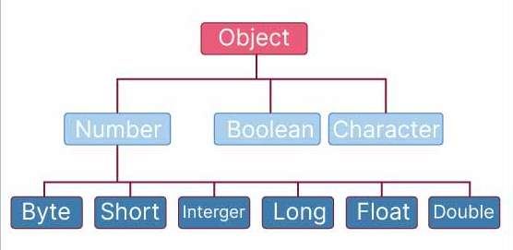
Wrapper Classes
The eight primitive data types, namely boolean, byte, short, int, long, float, double, and char, are not objects;
They cannot be passed by references and they are passed by value only.
In order to provide object representation, eight Wrapper classes are defined in java.lang package.
Pimitive Data Type | Wrapper Class
char | Character
byte | Byte
short | Short
int | Integer
long | Long
float | Float
double | Double
boolean | Boolean

Slide 33
Constructors of Wrapper Classes
class Byte
Byte (byte Numb)
Byte (String Strnumb) throws NumberFormatException
class Short
Short (short numb)
Short (String Strnumb) throws NumberFormatException
class Integer
Integer (int numb)
Integer (String Strnumb) throws NumberFormatException.
class Float
Float (float numb or double number)
Float (String Strnumb) throws NumberFormatException
The NumberFormatException occurs when the string is not in appropriate format.

Slide 34
Constructors of Wrapper Classes
class Double
Double(double d)
Double (String Strnumb) throws NumberFormatException
class Character
Character (char ch)
class Boolean
Boolean (boolean value)
Boolean (String boolstring)
Java has deprecated these constructors in favor of using valueOf() or autoboxing.
First see Ex1.java , then see UseofValueOf.java example program

Slide 35
Methods of Wrapper Classes
The valueOf() method is a static method available in wrapper classes such as Integer, Double, Float, and Boolean.
It converts a primitive value or a String into an object of the corresponding wrapper class.
Syntax:
  static T valueOf(type number)
  static T valueOf(String number)
T represents the wrapper class return type.
type number represents a primitive value.
String number represents a string containing a value.
UseofValueOf.java

Slide 36
Methods of Wrapper Classes
Integer Class
  public static Integer valueOf(int i)
  public static Integer valueOf(String s)
Double Class
  public static Double valueOf(double d)
  public static Double valueOf(String s)
Boolean Class
  public static Boolean valueOf(boolean b)
  public static Boolean valueOf(String s)

Slide 37
Methods of Wrapper Classes
Method | Description
byte byteValue() | is used to convert an object of a wrapper class (such as Integer, Float, Double, etc.) to a byte primitive type.
int intValue() | Returns the value as an int primitive type.
long longValue() | Returns the value as a long primitive type.
short shortValue() | Returns the value as a short primitive type.
double doubleValue() | Returns the value as a double primitive type.
float floatValue() | Returns the value as a float primitive type.
These methods are defined in the Number class (which is the superclass of classes like Integer, Long, Float, etc.), so they are available in various wrapper classes.
String toString() | Returns the string equivalent of invoking object
Ex2.java

Slide 38
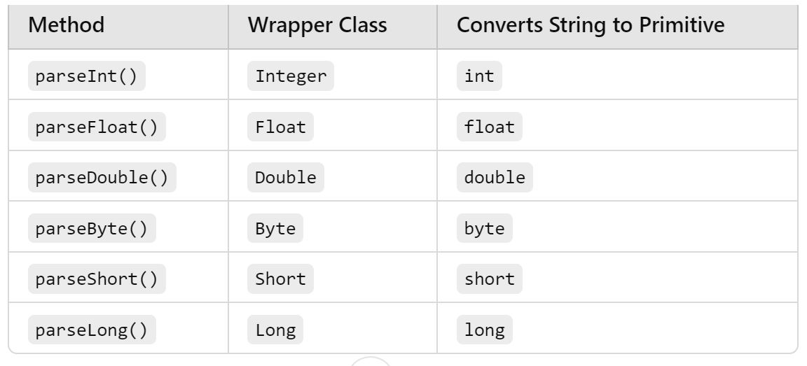
Methods for Conversion of Digital Strings into numbers
Parse methods convert a String containing a valid number into its corresponding primitive data type.
These static methods belong to wrapper classes such as Integer, Double, Float, Byte, Short, and Long.
Ex2.java

Slide 39
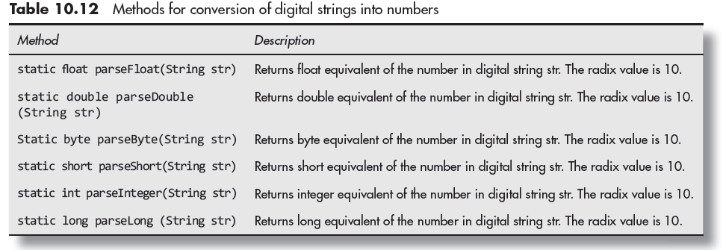

Slide 40
Auto-boxing and Un-boxing
Autoboxing is the automatic conversion of a primitive data type into its corresponding wrapper class object.
Examples:
int → Integer
double → Double
float → Float
boolean → Boolean
long → Long
Ex: int a = 100;
Integer obj = a;
Autoboxing and unboxing were introduced in Java 5 (JDK 1.5).

Slide 41
Unboxing
Unboxing is the automatic conversion of a wrapper class object into its corresponding primitive data type.
Ex:
Integer obj = 200;
int b = obj;
Remember:
Autoboxing: Primitive to object.
Unboxing: Object to primitive.

Slide 42
Methods isInfinite() and isNaN()
The methods isInfinite() and isNaN() are used in Java to check if a floating-point value is either infinite or "Not-a-Number" (NaN).
These methods are available in the Double and Float wrapper classes.
isInfinite() is occurer due to large number/small number
  Ex: 2522256897771/2, number/0
isNaN() checks whether the invoking object is number or not

Slide 43
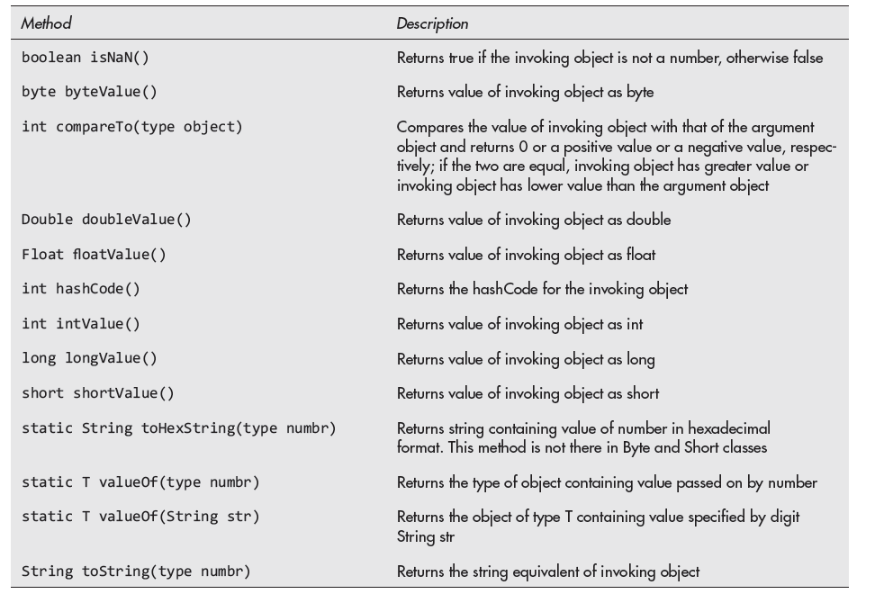
As per textbook

Slide 44
Exception Handling
Exception Handling
types of errors
  Compile, run-time, logical errors(incorrect o/p)
    Logical Errors
    Multiplying when you should be dividing
    Adding when you should be subtracting
    Opening and using data from the wrong file
    Displaying the wrong output
Exceptions – occurred during running and classified into checked or unchecked.
An exception is undesirable that may occur during the execution of the program and may lead to termination of the program if it is not handled properly.
    try
    catch
    throw - explicitly raise
    throws – not in a position to handle
    finally – always execute irrespective of exception occurred or not

Slide 45
General form-of exception handling block
try {
// block of code to monitor for errors
}
catch (ExceptionType1 exOb) {
// exception handler for ExceptionType1
}
catch (ExceptionType2 exOb) {
// exception handler for ExceptionType2
}
// ...
finally {
// block of code to be executed after try block ends
}
Here, ExceptionType is the type of exception that has occurred.

Slide 47
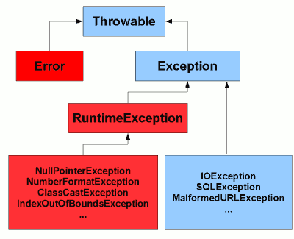
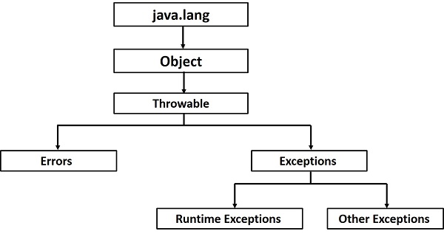
Exception heirarchy
Error - Out of memory error or a System crash error

Slide 48
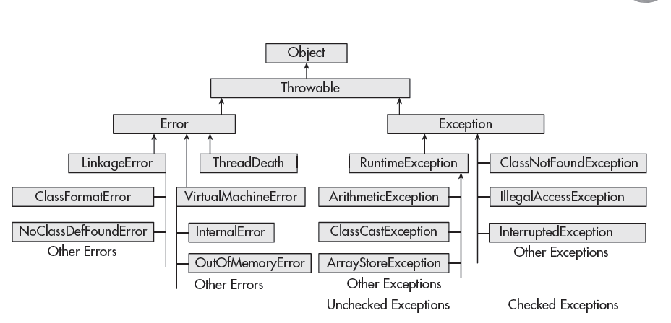

Slide 49
FAQs
What is Throwable?
  Throwable is a super class that represents all errors and exceptions
Which is the super class for all exceptions?
What is the difference between exception & error?
  An exception is an error which can be handled. It means when an exception happens, the programmer can do something to avoid harm.
  But an error is an error which can not be handled (Programmer can not do anything –catastrophically errors)
What are checked exceptions?
  That are checked at compilation time by the Java compiler - JVM
What are unchecked exceptions?
  That are checked by JRE

Slide 50
Working of try-catch
try block contains the code that may cause an exception.
catch block is used to handle the exception if it occurs.
If no exception occurs:
  All statements in the try block execute normally.
  The catch block is skipped.
  Program execution continues after the catch block(s).
If an exception occurs:
  Java creates an exception object.
  The exception object contains information about the exception, including its type.
The remaining statements in the try block are not executed.
Java comes out of the try block and searches for a matching catch block.
If a suitable catch block is found, the exception is handled there.

Slide 51
try block
|
Exception occurs?
/ \
NO YES
| |
Continue Exception
normally object
| |
| Find matching catch
| |
| Handle exception
| |
+-------> Continue program

Slide 53
catch block
A catch block handles an exception when the exception type matches the type specified in the catch block.
If the first catch block does not match, Java checks the next catch block.
This checking continues from top to bottom until a matching catch block is found.
When a matching catch block is found, its statements are executed, and the remaining catch blocks are skipped.
If no catch block matches, the exception remains uncaught.
If a finally block is present, it executes before the program terminates due to the uncaught exception.

Slide 55
Multiple catch clauses
In some cases, more than one exception could be raised by a single piece of code.
To handle this type of situation, you can specify two or more catch clauses, each catching a different type of exception.
When an exception is thrown, each catch statement is inspected in order, and the first one whose type matches that of the exception is executed.
If one catch statement is executed, the others are bypassed, and execution continues after the try / catch block.

Slide 56
When you use multiple catch statements, it is important to remember that exception subclasses must come before any of their super classes.
This is because a catch statement that uses a super class will catch exceptions of that type plus any of its subclasses. Subclass would never be reached if it came after its super class.
Since Java 7, a modification has been done in the language so that one catch block can catch more than one type of exception.
  The exception classes are connected by Boolean | (or) operator |.
  Ex: catch (ArithmeticException | NullPointerException e) { }

Slide 57
Java finally block
Java finally block is a block that is used to execute important code such as closing connections (databases, network, disks, commit in databases) etc.
Java finally block is always executed whether exception is handled or not.

Slide 58
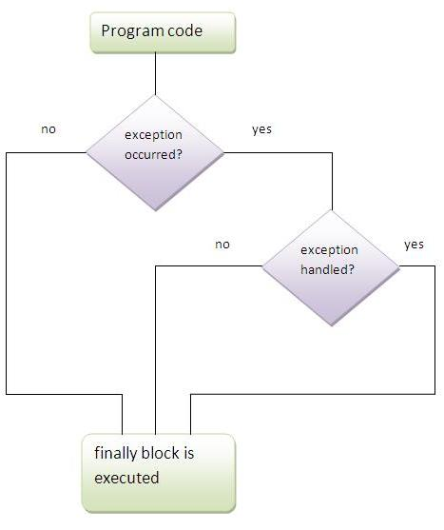

Slide 59
Use of throw – to generate and for rethrowing exceptions
So far, you have only been catching exceptions that are thrown by the Java run-time system. However, it is possible for your program to throw an exception explicitly, using throw statement.
The general form of throw is shown here:
  throw ThrowableInstance;
Here, ThrowableInstance must be an object of type Throwable or a subclass of Throwable.

Slide 60
There are two ways to obtain a Throwable instance:
- creating one with the new operator
throw new exception_class("error message");
- using the parameter of catch clause -
throw exception_type_variable; (For rethrowing)
The flow of execution stops immediately after the throw statement; any subsequent statements are not executed.
The nearest enclosing try block is inspected to see if it has a catch statement that matches the type of exception.
If it does find a match, control is transferred to that statement.
If no matching catch is found, then the default exception handler halts the program and prints the stack trace.

Slide 61
Use of throws clause
throws is a keyword in Java used at the method declaration/signature.
It indicates that a method may throw one or more exceptions.
It is mainly used to declare checked exceptions. It can also list unchecked exceptions, but declaring unchecked exceptions is not mandatory.
The caller of the method must handle a declared checked exception using try-catch or further declare it using throws.
type method-name(parameter-list) throws exception-list
{
// body of method
}

Slide 62
Custom or Userdefined Exceptions
We can also create our own exception by creating a sub class simply by extending java Exception class.
class UserException extends Exception
Define a constructor in UserException (optional)
  UserException(); -> Creates an exception without a description/message.
  UserException (parameter); -> Creates an exception with a custom description/message
To print custom messages:
  Override toString() method
  toString() method to display customized message in catch clause.

Slide 63
Class Throwable
The class is declared as
public class Throwable extends Object
implements serializable
Throwable is the root of Java's error and exception hierarchy.
Only Throwable objects (or subclasses) can be thrown with throw.
Only Throwable types can appear as the parameter of a catch clause.

Slide 64
Constructors of class Throwable
Throwable(): the detail message is null and no cause is set.
Throwable(String message): stores your message, retrievable with getMessage().
Throwable(String message, Throwable cause): used for exception chaining, where you wrap a low-level exception inside a higher-level one and keep both messages.
Throwable(Throwable cause): the message is automatically set to cause.toString() (or null if the cause is null).
  Throwable t1 = new Throwable(); // message = null
  Throwable t2 = new Throwable("Something failed"); // message set
  Throwable t3 = new Throwable("Wrapper", cause); // message + cause
  Throwable t4 = new Throwable(cause); // cause only

Slide 65
Methods
String getMessage() | Returns the detail message
String toString() | Returns the class name, plus ": " and the message if one exists.
Throwable getCause() | Returns the cause, or null if none or unknown.
void printStackTrace() | Prints the exception and its stack trace to standard error (System.err).
StackTraceElement[] getStackTrace() | Returns the trace as an array; each element holds class, method, file and line number.

Slide 66
Methods of class Throwable

Slide 67
Unchecked Exceptions
The unchecked exception classes are subclasses of class
RuntimeException, which is further a subclass of class Exception.
The runtime exceptions are not checked by the compiler.
These exceptions form a subgroup of classes that are subclasses of class Exception.

Slide 68
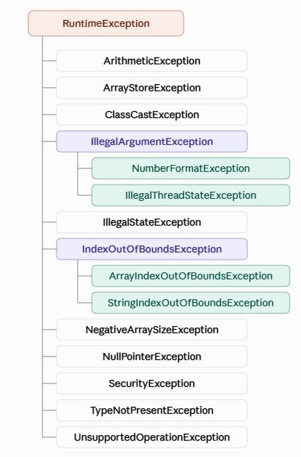
Unchecked subclasses of RuntimeException

Slide 69
Exception | Typical trigger
ArithmeticException | int x = 10 / 0;
ArrayIndexOutOfBoundsException | int[] a = new int[3]; a[5] = 1;
ArrayStoreException | Object[] o = new String[2]; o[0] = 10;
ClassCastException | Object o = "hi"; Integer i = (Integer) o;
IllegalArgumentException | Passing an invalid value, e.g. Thread.sleep(-1)
IllegalStateException | Calling a method at the wrong time, e.g. iterator.remove() before next() Iterator<String> it = list.iterator(); it.next(); // Move to the first element it.remove();
IllegalThreadStateException | Calling start() twice on the same thread

Slide 70
Exception | Typical trigger
IndexOutOfBoundsException | List<String> list = new ArrayList<>(); list.add("A"); list.add("B"); list.add("C"); list.get(10);
NegativeArraySizeException | int[] a = new int[-5];
NumberFormatException | Integer.parseInt("abc");
NullPointerException | String s = null; s.length();
SecurityException | Code violating a security manager's rules

Slide 71
Checked Exceptions
The compiler forces you to either catch them with try-catch or declare them with throws.
They represent problems that can happen even in correct code, usually because of the outside environment (missing files, missing classes, interrupted threads).

Slide 72
Exception | Typical trigger
ClassNotFoundException | Class.forName("com.missing.Foo"); //is used to load a class into the JVM at runtime.
FileNotFoundException | new FileReader("missing.txt");
IllegalAccessException | Using reflection to access a private member or class without permission
InstantiationException | Class.forName("MyAbstractClass").newInstance(); via reflection
InterruptedException | Thread.sleep(1000); when another thread interrupts it
NoSuchFieldException | MyClass.class.getField("nofield");
NoSuchMethodException | MyClass.class.getMethod("nomethod");

Slide 73
Java I/O and File: Java I/O API, standard I/O streams, types, Byte streams, Character streams, Scanner class, Files in Java: File, FileInputStream and FileOutputStream Classes

Slide 74
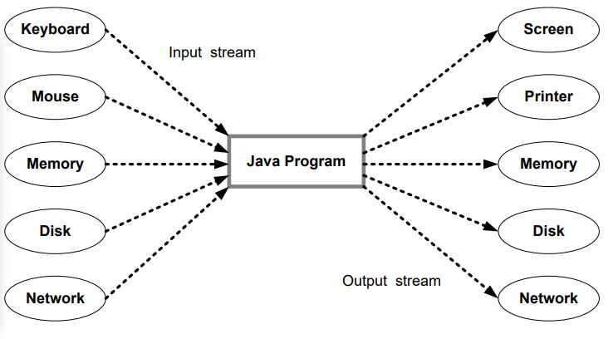
Stream in Java
Java treats flow of data as stream.
Java streams are classified into two basic types, namely, input stream and output stream.
The java.io package contains a large number of stream classes to support the streams.

Slide 76
I-O stream classes in Java
Java provides java.io package which contains a large number of stream classes to process all types of data
Byte stream classes
  Support for handling I/O operations on bytes
Character stream classes
  Supports for handling I/O operations on characters

Slide 77
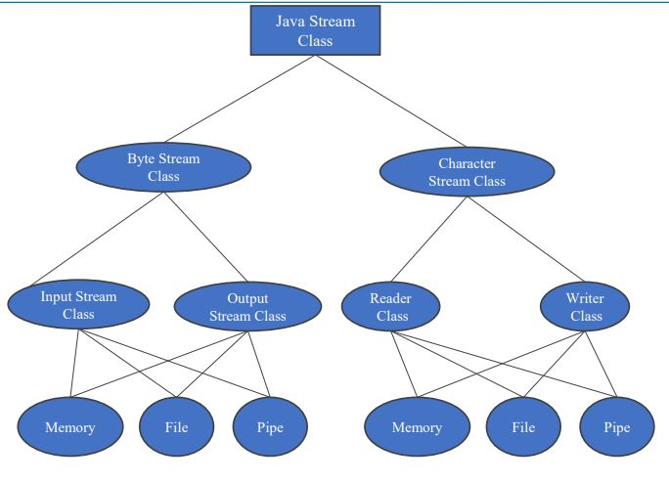

Slide 78
Java provides a rich set of classes for performing I/O operations. Some of the key classes include:
  InputStream and OutputStream: These abstract classes form the foundation for byte-oriented I/O operations. They provide methods for reading and writing bytes from/to various sources and destinations.
  Reader and Writer: These abstract classes are used for character-based I/O operations. They provide methods for reading and writing characters from/to character-based streams.
  FileInputStream and FileOutputStream: These classes allow reading from and writing to files in a byte-oriented manner.
  FileReader and FileWriter: These classes enable reading from and writing to files using character-oriented operations.
  BufferedInputStream and BufferedOutputStream: These classes provide buffering capabilities, which can significantly improve I/O performance by reducing the number of system calls.
  BufferedReader and BufferedWriter: These classes offer buffered reading and writing of character data, enhancing I/O efficiency when working with character-based streams.

Slide 79
In Java, 3 streams are created for us automatically.
All these streams are attached with the console (The console is typically the terminal or command line where you can input data and see output).
  1) System.out: standard output stream
  2) System.in: standard input stream
  3) System.err: standard error stream
  Example programs to read data StandardInputDemo.java, ConsoleDemo.java

Slide 80
Java Input Stream Classes
FilterInputStream is an abstract class
ByteArrayInputStream – reads the data in terms of bytes (images, audio files…)

Slide 81
Important Points
FileInputStream | Reading from a file
ByteArrayInputStream | Reading from memory
FilterInputStream | Additional functionality
PipedInputStream | Receiving data between threads
ObjectInputStream | Reading objects
DataInputStream | Reading primitive data
BufferedInputStream | Faster reading using a buffer
PushbackInputStream | Pushing back and rereading bytes

Slide 82
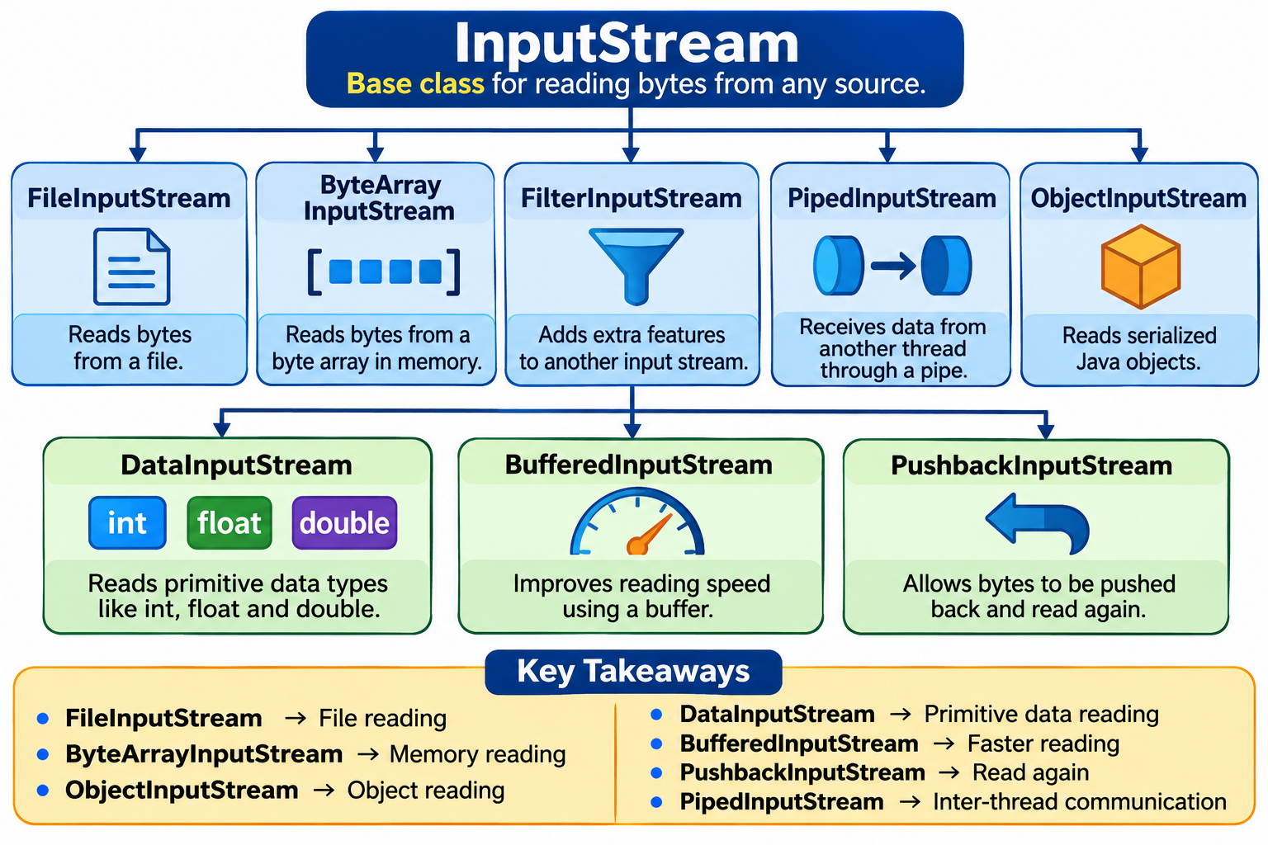

Slide 83
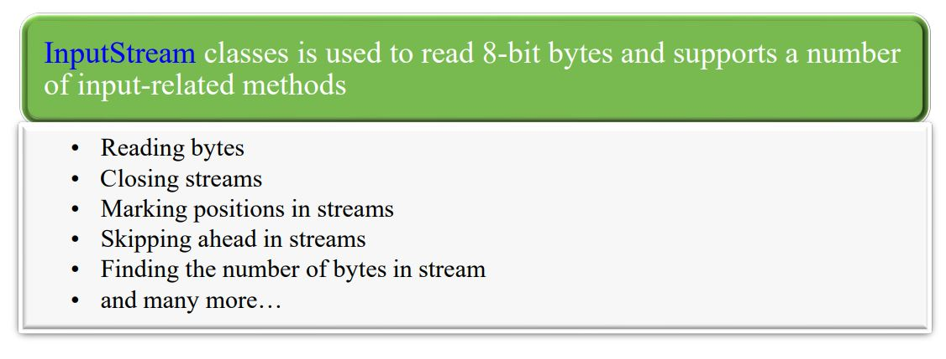
Java input stream classes

Slide 84
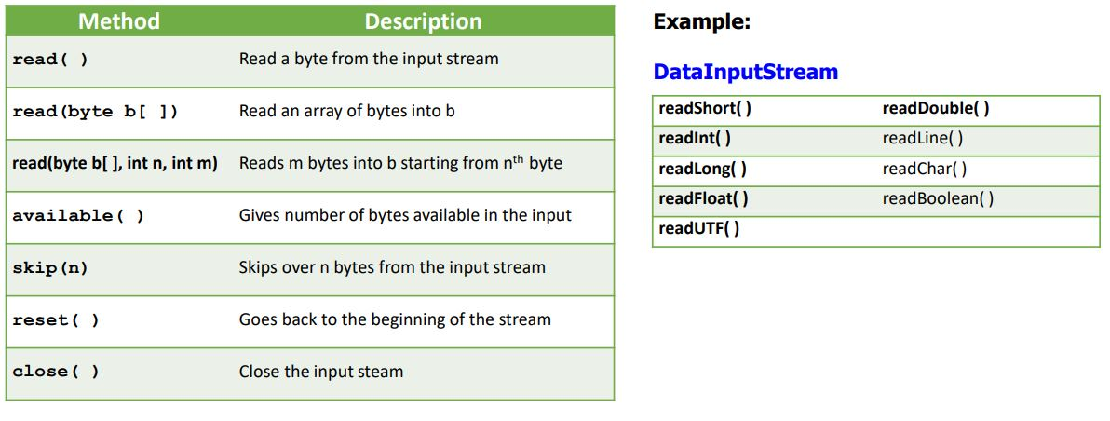
Useful Methods of InputStream Class

Slide 85
Useful Methods of InputStream Class
Reading bytes
  int read()
  int read (byte b[]) – read an array of bytes into an array
  int read (byte b[], int off, int len)
Closing streams
  void close()
Finding the number of bytes in a stream
  int available()
Skipping ahead in a stream
  long skip (long n)
Marking positions in a stream
    - void mark (int limit)
    - void reset()
    - boolean markSupported()

Slide 86
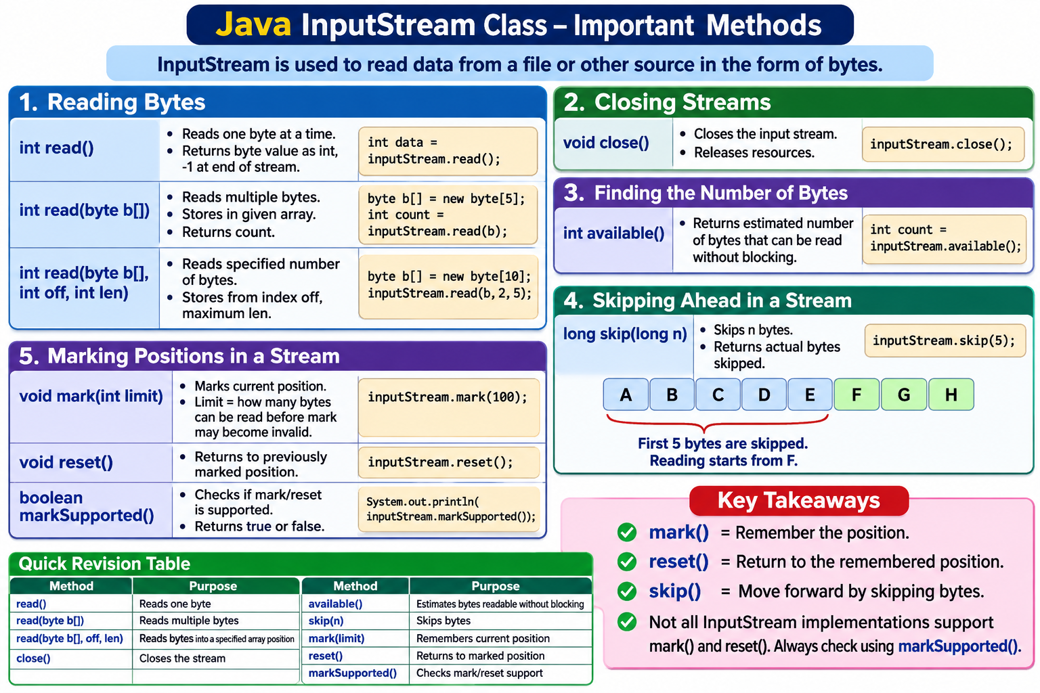

Slide 87
DataInputStream Class Methods
Method | Purpose
readBoolean() | Reads a boolean value.
readByte() | Reads 1 byte.
readChar() | Reads 2 bytes (character).
readDouble() | Reads 8 bytes.
readFloat() | Reads 4 bytes.
readInt() | Reads 4 bytes.
readLong() | Reads 8 bytes.
readShort() | Reads 2 bytes.
readUTF() | Reads a modified UTF-8 string.
Unicode Transformation Format – 8-bit - UTF-8 helps computers represent text from almost all languages, including English, Telugu, Hindi and many others. Size varies from 1–4 bytes.

Slide 88
Java Output Stream Classes
OutputStream classes is used to write 8-bit bytes and supports a number of output-related methods
  Writing bytes
  Closing streams
  Flushing streams
    etc.

Slide 89
OutputStream Classes Hierarchy

Slide 90
Important points
FileOutputStream → File
ByteArrayOutputStream → Memory
DataOutputStream → Primitive data
BufferedOutputStream → Buffer
ObjectOutputStream → Objects
PrintStream → Printing data
PipedOutputStream → Thread communication
FilterOutputStream → Additional functionality

Slide 91
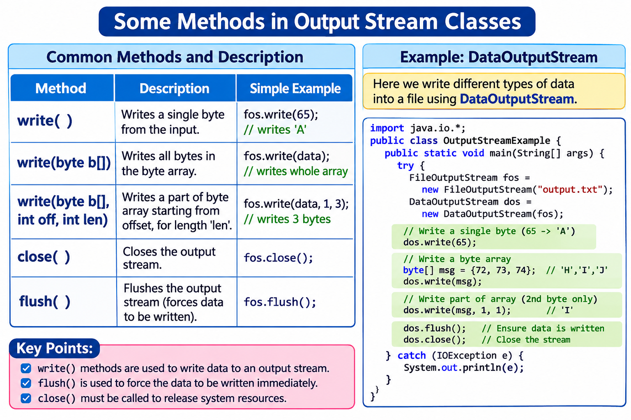

Slide 92
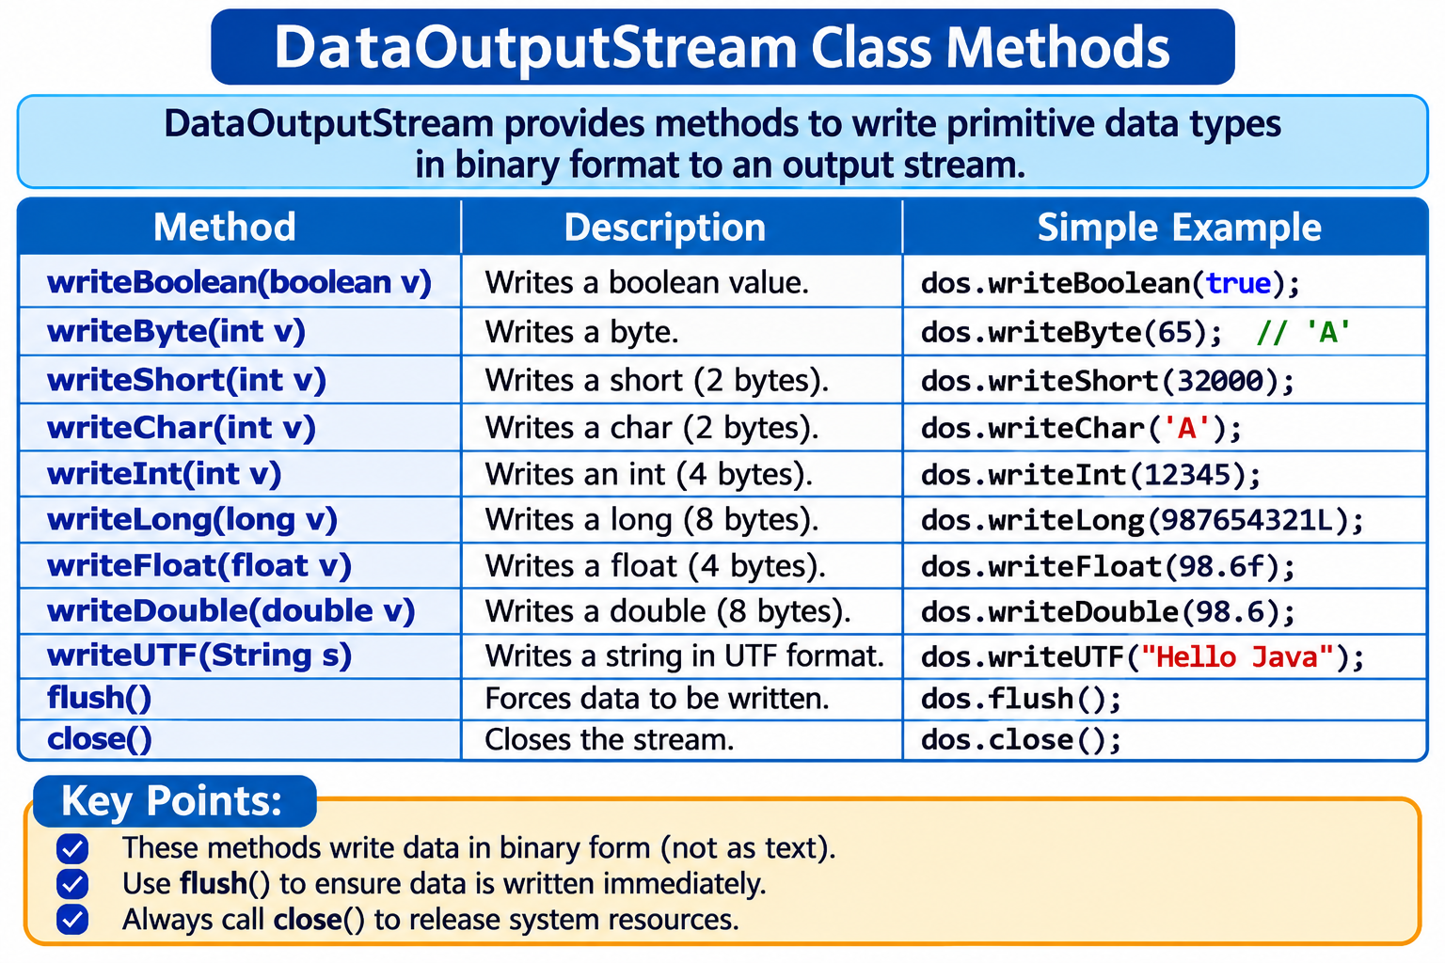

Slide 93
Useful Methods of OutputStream Class
Method | Description
public void write(int) throws IOException | It is used to write a byte to the current output stream.
public void write(byte[])throws IOException | It is used to write an array of byte to the current output stream.
public void flush() throws IOException | It flushes the current output stream.
public void close() throws IOException | It is used to close the current output stream.

Slide 94
Character stream classes
Character stream classes are used to read and write characters and supports a number of input-output related methods
Reader stream classes
  To read characters from files.
  Identical to InputStream classes.
Writer stream classes
  To write characters into files.
  In many ways, identical to OutputStream classes.

Slide 95
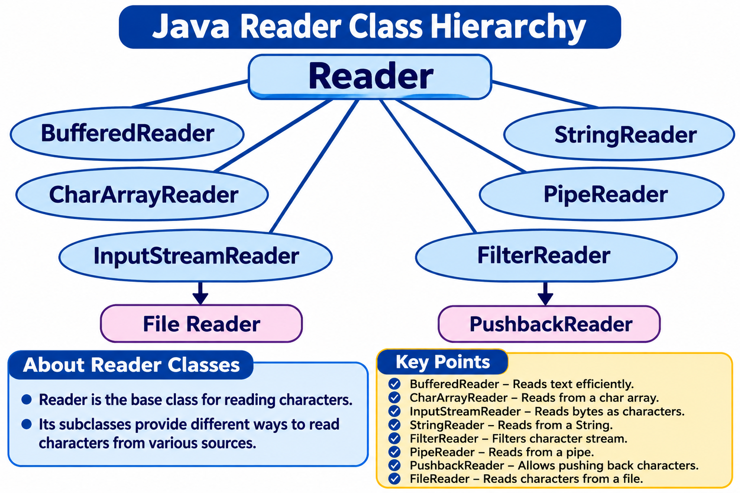
Reader Class

Slide 96
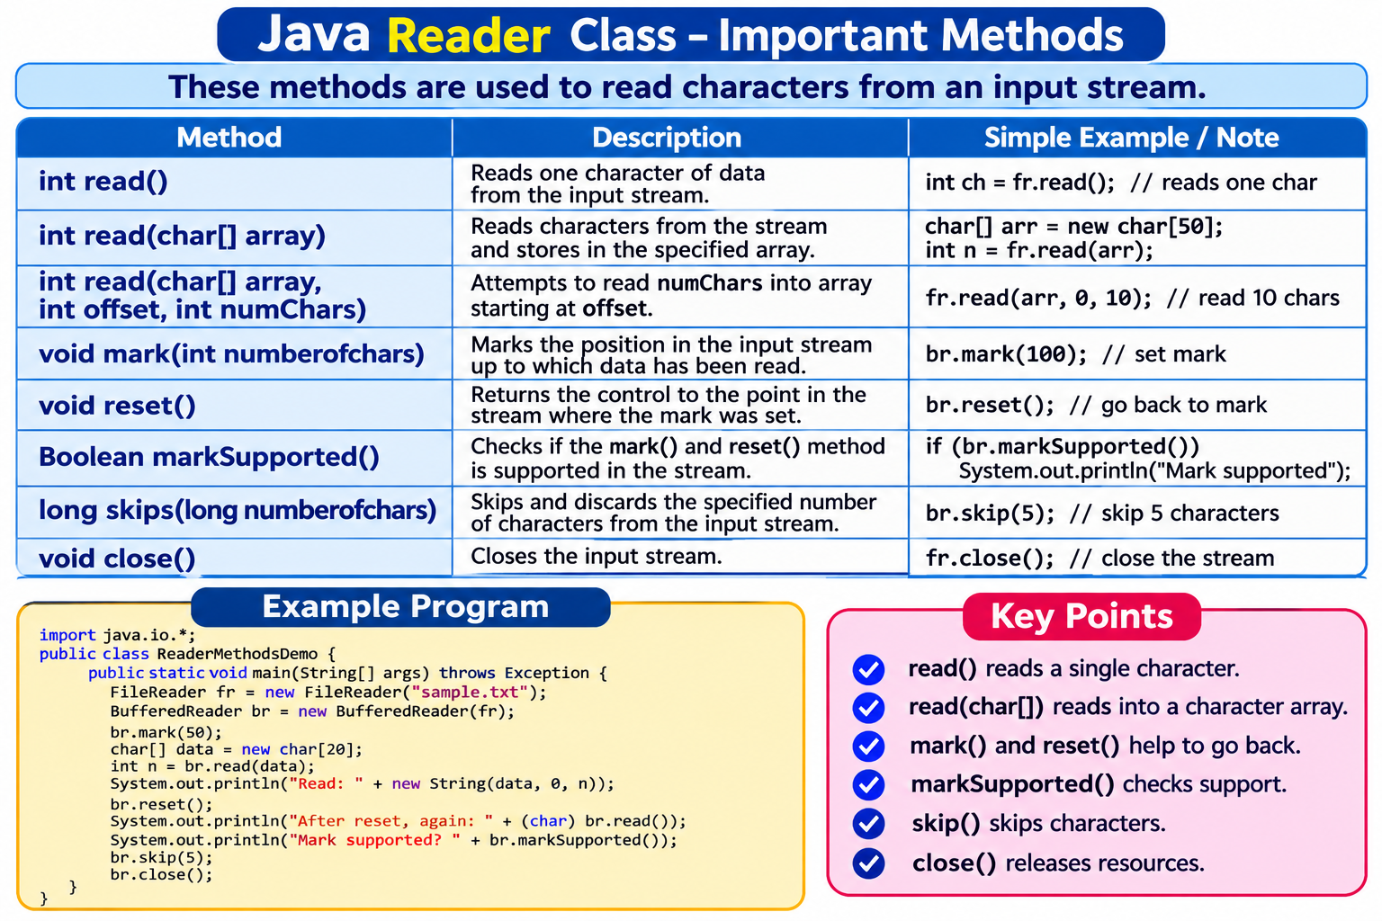
Reader class Methods

Slide 97
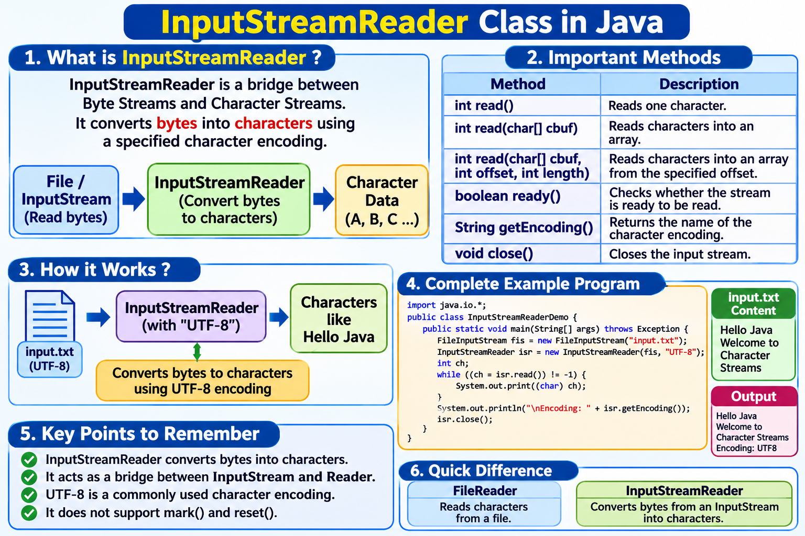

Slide 98
BufferedReader class Methods
Method | Description
int read() | It is used for reading a single character.
int read(char[] cbuf, int offset, int len) | It is used for reading characters into an array
String readLine() | It is used for reading a line of text.
boolean ready() | It is used to test whether the input stream is ready to be read.
long skip(long n) | It is used for skipping the characters.
void close() | Closes the stream

Slide 99
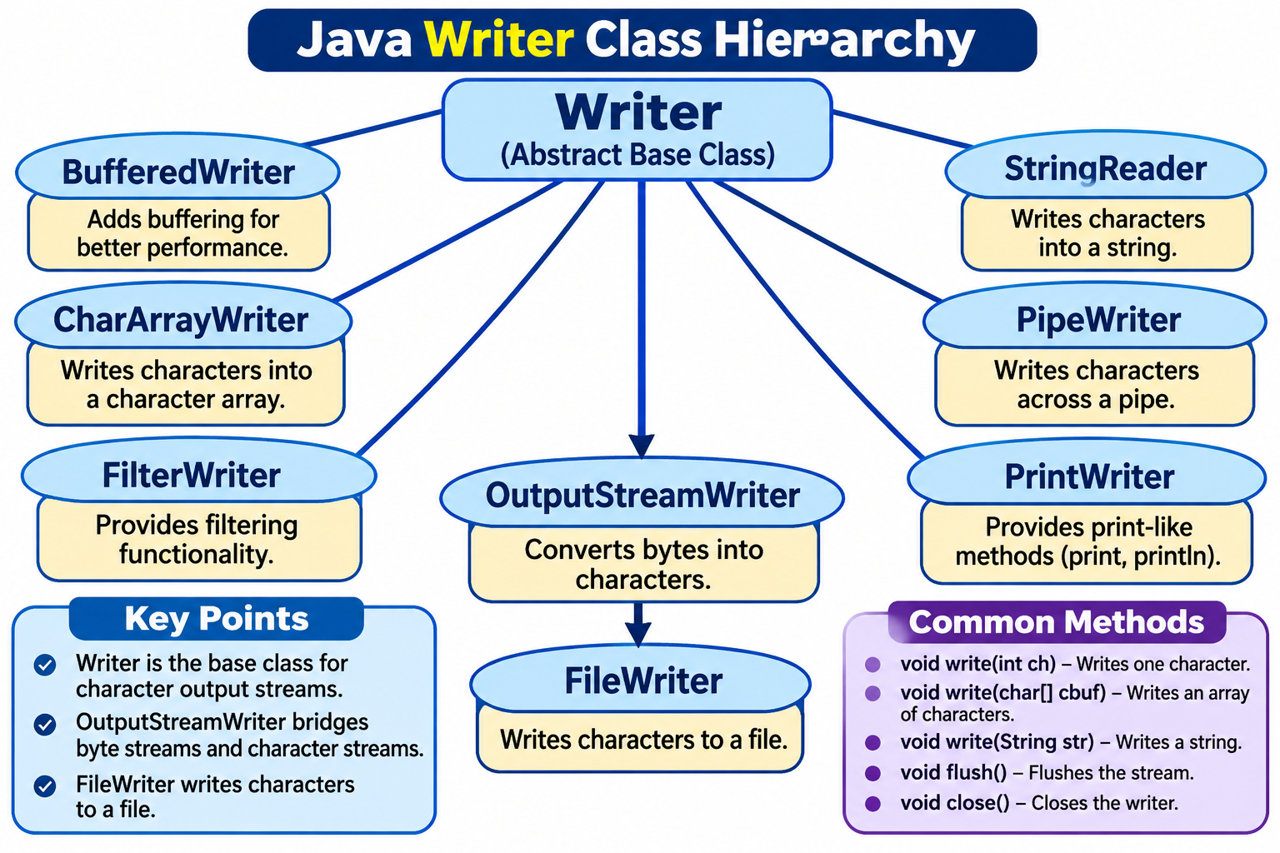
Writer Class

Slide 100
Writer class Methods
Method | Simple explanation
write(int c) | Writes a single character.
write(char[] cbuf) | Writes an entire character array.
write(char[] cbuf, int off, int len) | Writes selected characters from an array.
write(String str) | Writes a complete string.
append(CharSequence csq) | Appends a character sequence.
flush() | Forces pending data to be written.
close() | Closes the writer.

Slide 101
File Class
In Java, the File class is used to represent files and directories (folders) in a computer system.
It belongs to the java.io package.
This class allows you to manipulate files and directories (e.g., create, delete, check properties) but doesn’t read or write file content.
To read or write content, you need to use classes like FileInputStream, FileOutputStream, FileReader, FileWriter

Slide 102
File Class
The File class does not directly read or write the contents of a file.
It is mainly used to perform file and directory operations such as:
  Creating a new file.
  Checking whether a file exists.
  Deleting a file.
  Getting the file name and path.
  Checking file permissions.
  Creating directories.
  Listing files inside a directory.
  Getting file information such as size and last modified time.

Slide 103
Creating a File Object
File f = new File("students.txt");
Explanation:
    File – Class name.
    f – Reference variable.
    new – Creates an object.
    File("students.txt") – Specifies the file path.
Creating a File object does not create an actual file on the computer. It only creates a Java object representing the specified path

Slide 104
Constructors:
File(String pathname): Creates a File instance for the specified pathname
File(String parent, String child) - Creates a File object using parent and child paths.
File f2 = new File("D:\\Java", "students.txt");
File(File parent, String child) - Uses an existing File object as the parent.
File parent = new File("/user/docs");
  File file = new File(parent, "example.txt");

Slide 105
Methods
Purpose | Method and Description
File and Directory creation | createNewFile(): atomically creates a new, empty file . mkdir() - Creates a directory mkdirs() – Creates a nested directories

Slide 106
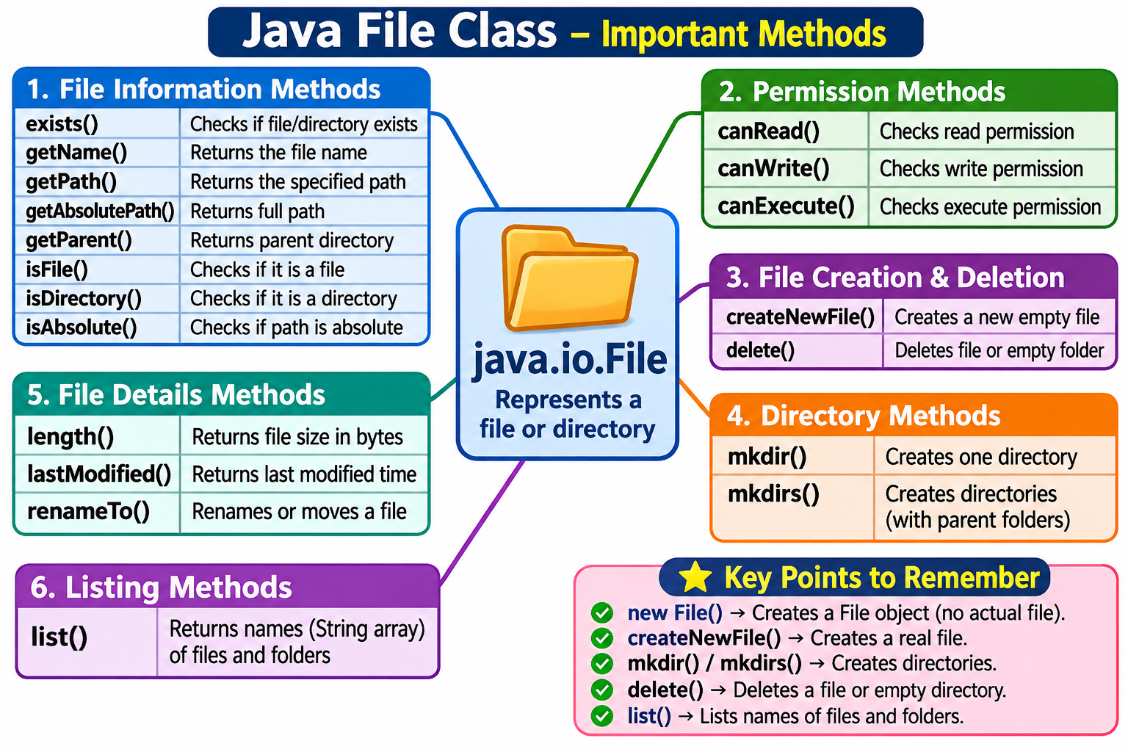

Slide 107
FileInputStream Class
FileInputStream(File file): Creates a FileInputStream by opening a connection to the specified file.
FileInputStream(String pathname): Creates a FileInputStream by opening a connection to the file specified by the path.

Slide 108
FileOutputStream class
FileOutputStream(File file): Creates a FileOutputStream that writes to the specified File.
FileOutputStream(String path): Creates a FileOutputStream that writes to the file specified by the path.
FileOutputStream(File file, boolean append): Creates a FileOutputStream for the specified file, with an option to append data instead of overwriting.
FileOutputStream(String path, boolean append): Creates a FileOutputStream for the specified path, with an option to append.

